Slide 1
Trash Classification in Shopping CenteRs

Slide 2
Overview
Problem:
Many people sometimes get confusion when choosing between recycling bin and non-recycling bin for throwing metal cans, plastic bottles, milk boxes after use.
Many people don’t care about recycling or non-recycling when throwing trash after use.
Solution:
Smart bins can be used to detect and classify trash automatically.

Slide 3
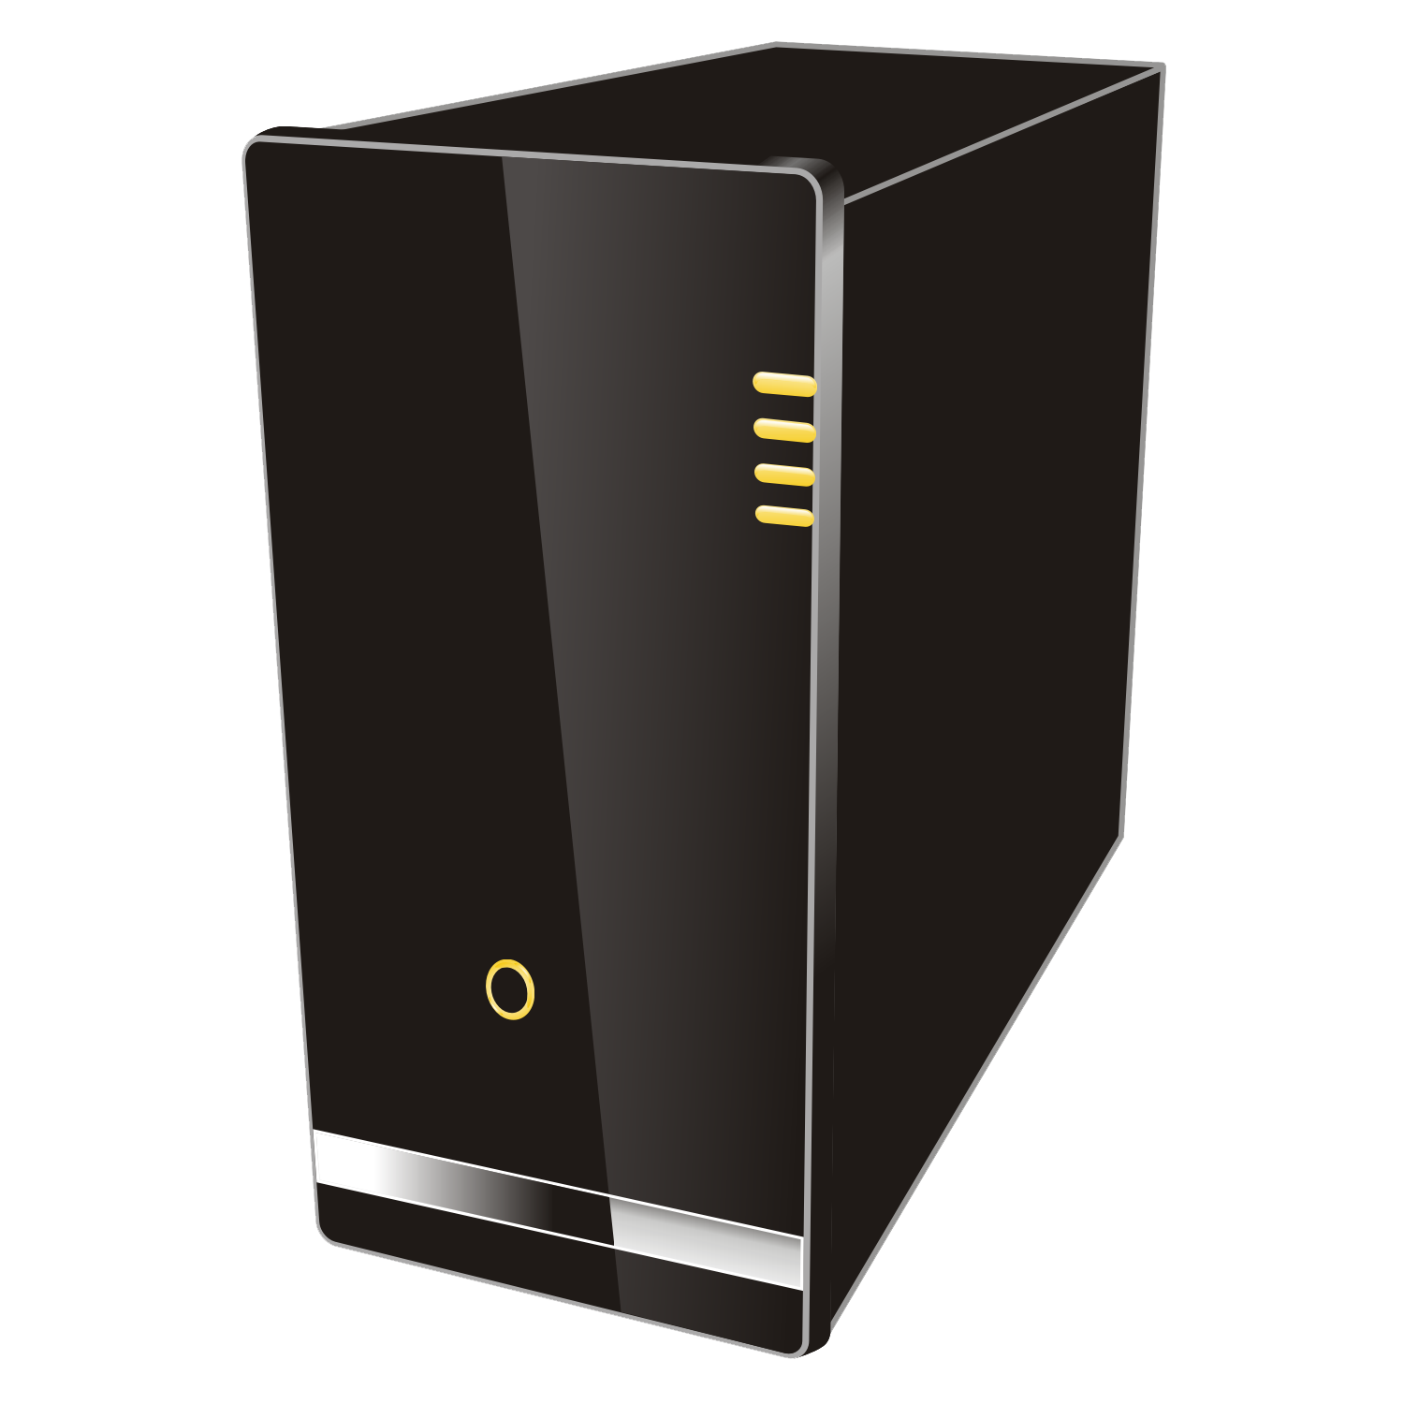

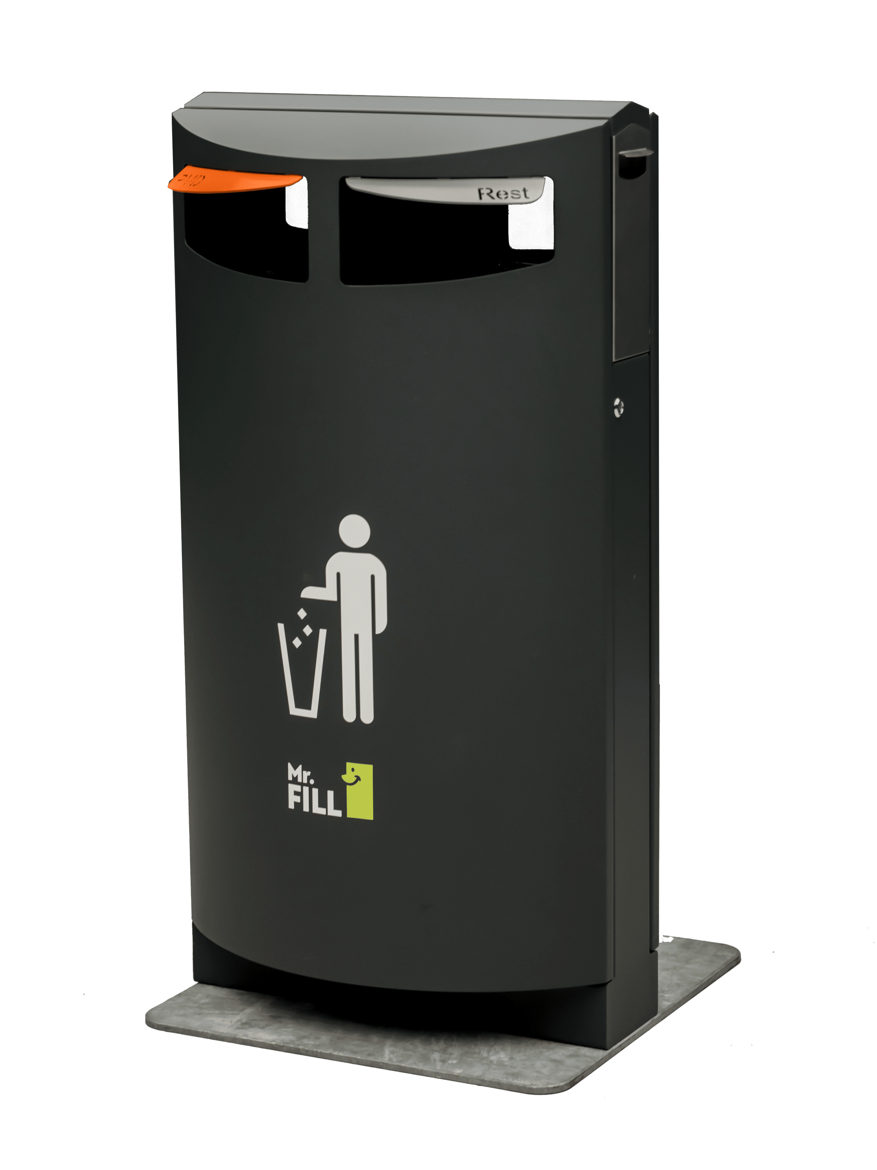
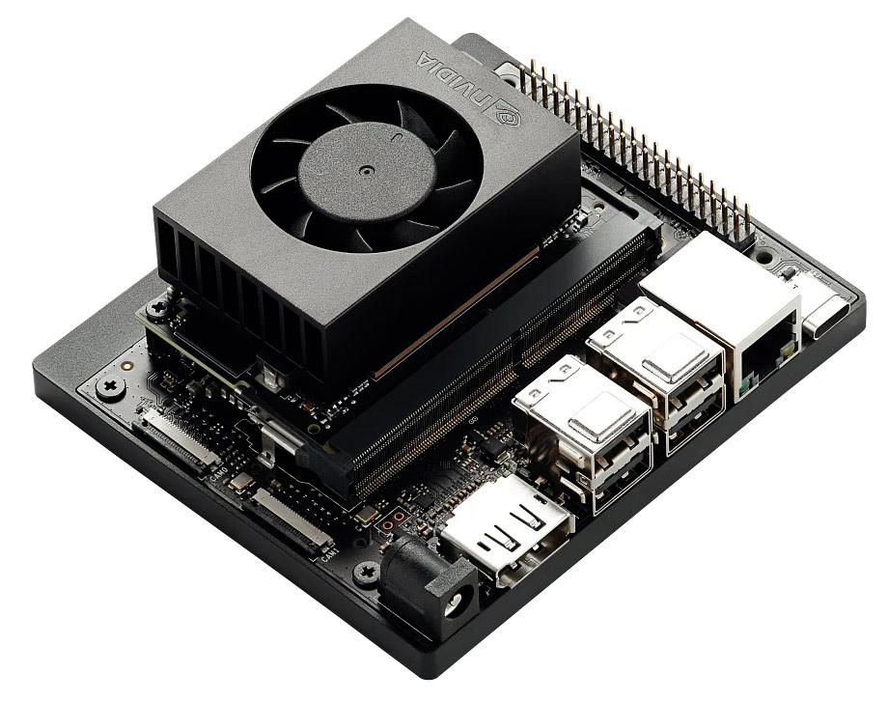
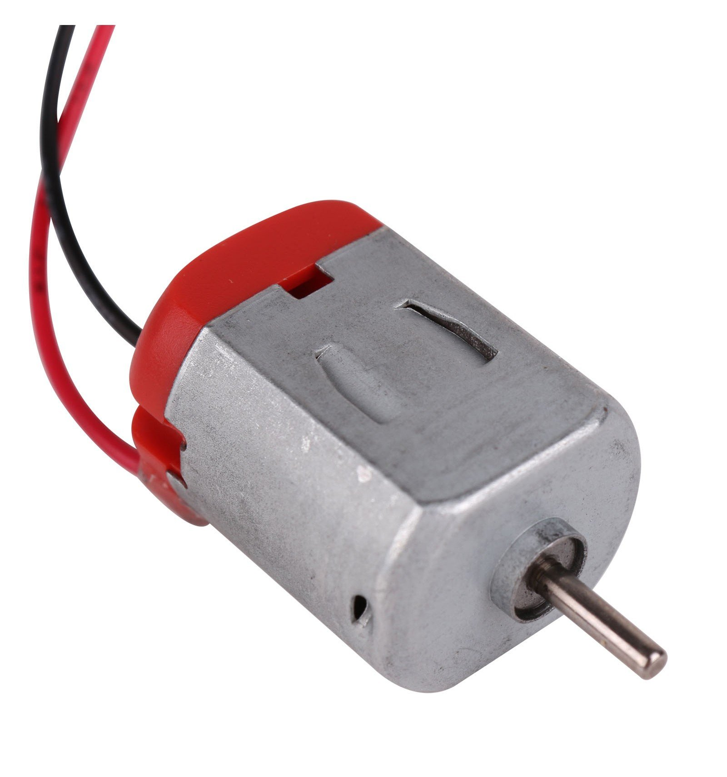
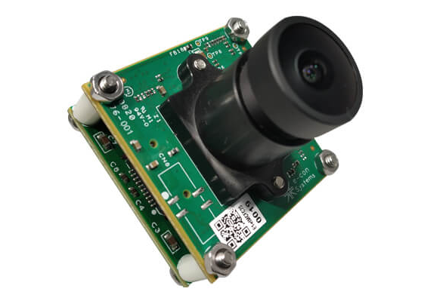
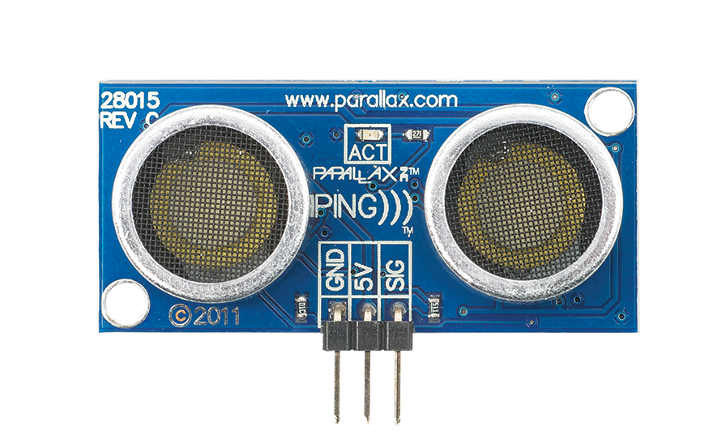
Solution diagram
Notification
Web server
Wifi
CSI camera
Jetson nano
DC motor
Ultrasonic sensor

Slide 4
Feature workflow
Jetson nano detects trash type via camera which is triggered by ultrasonic sensors when there is a people stands in front of the trash bin
Jetson nano controls DC motor to open correct lid
Jetson nano reads ultrasonic sensor to check if the bin is full
Web server sends notification to mobile app to update bin status
Jetson nano sends status to web server

Slide 5
AI model on Jetson Nano
SSD-Mobilenet is used to retrain following this guideline: jetson-inference/docs/pytorch-ssd.md at master · dusty-nv/jetson-inference · GitHub
Classes to train based on popular food and drink used in shopping centers:
Soft drink and beer metal cans made by Coca Cola, Pepsi, Tiger, Heineken…
Water bottles such as spring water, milk bottle, soft drink…
Coffee/Tee plastic cups
Milk boxes
In the demo, plastic bottle and metal can are the two classes. Images for training was collected from internet, annotated and exported to VOC format by using CVAT.ai web app.

Slide 6
Demo
Pre-condition:
- Set up the Jetson nano 4GB and a raspberry camera (CSI camera): just follow the guideline jetson-inference/docs/building-repo-2.md at master · dusty-nv/jetson-inference · GitHub . I did not use the docker image.
Use 1 red led to connect to GPIO pin 11 and 1 green led to connect to GPIO pin 12. The two leds are to simulate lid open/close control: when a led lights it means the corresponding lid is opened. Red led is for recycling bin and green led is for non-recycling bin.
The model is retrained and exported to Onxx.
Step 1: Navigate to ssd folder, e.g.: “~/Documents/Chau/jetson-inference/python/training/detection/ssd” where “Chau” should be replaced by your username.
Model file is in: ~/Documents/Chau/jetson-inference/python/training/detection/ssd/models/trash2
Step 2: On terminal, run “python3 trash_bin_demo.py” . In order to simulate the trigger by ultrasound sensors, I let user to input “s” to start the detection and input “esc” to exit the program.

